Slide 1
Machine Learning for Neuroscience
Introduction to machine learning
Payam Barnaghi
Department of Brain Sciences
Imperial College London
January 2024
Notes:
1

Slide 2
Leia: Yaté. Yaté. Yotó. (SUBTITLE: “I have come for the bounty on this Wookiee.”)
C-3PO relays this message and Jabba says he’ll offer 25,000 for Chewie.
Leia: Yotó. Yotó. (SUBTITLE: “50,000, no less.”)
C-3PO relays this message and Jabba asks why he should pay so much.
Leia: Eí yóto.
The above isn’t subtitled, but Leia pulls out a bomb and activates it.
C-3PO : Because he’s holding a thermal detonator!
Jabba is impressed by this and offers 35,000.
Leia: Yató cha.
The above isn’t subtitled, but Leia deactivates the bomb and puts it away.
C-3PO : He agrees.
Order is restored.
Adapted from: The Art of Language Invention: From Horse-Lords to Dark Elves, The Words Behind World-Building, by David J. Peterson.

Slide 3
Leia: Yaté. Yaté. Yotó. (SUBTITLE: “I have come for the bounty on this Wookiee.”)
C-3PO relays this message and Jabba says he’ll offer 25,000 for Chewie.
Leia: Yotó. Yotó. (SUBTITLE: “50,000, no less.”)
C-3PO relays this message and Jabba asks why he should pay so much.
Leia: Eí yóto.
The above isn’t subtitled, but Leia pulls out a bomb and activates it.
C-3PO : Because he’s holding a thermal detonator!
Jabba is impressed by this and offers 35,000.
Leia: Yató cha.
The above isn’t subtitled, but Leia deactivates the bomb and puts it away.
C-3PO : He agrees.
Order is restored.
Adapted from: The Art of Language Invention: From Horse-Lords to Dark Elves, The Words Behind World-Building, by David J. Peterson.

Slide 4
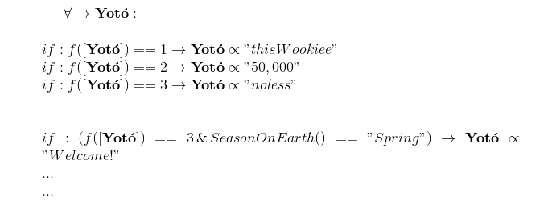

Slide 5
However, don’t underestimate the human brain
For example, in German:
you have to distinguish between “the” and “a” articles
and then each one has four case forms
three genders
and singular and plural forms
and then the adjectives have to agree
and then there are verbs!
or, take this as an example:
(biáng)
Adapted from: The Art of Language Invention: From Horse-Lords to Dark Elves, The Words Behind World-Building, by David J. Peterson.

Slide 6

Source: https://www.originofalphabet.com/meow-is-just-another-name-for-cat-2/

Slide 7

Source: https://cdn.sinauer.com/wolfe4e/wa07.05.html#Movie1

Slide 8
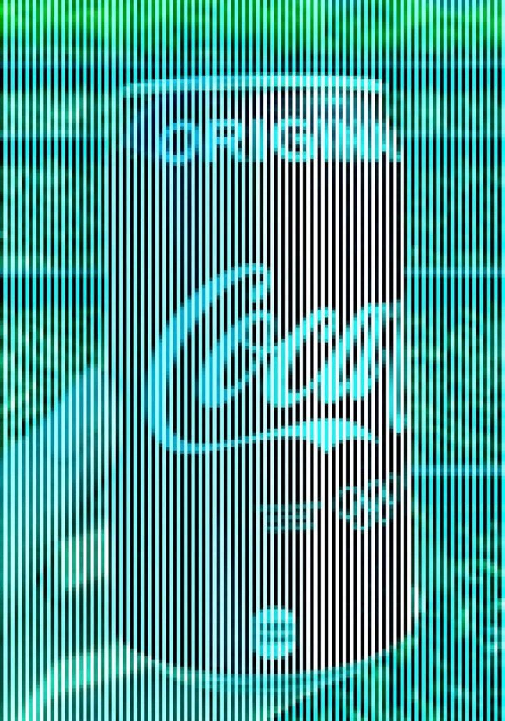


Patterns and generalisation

Slide 9
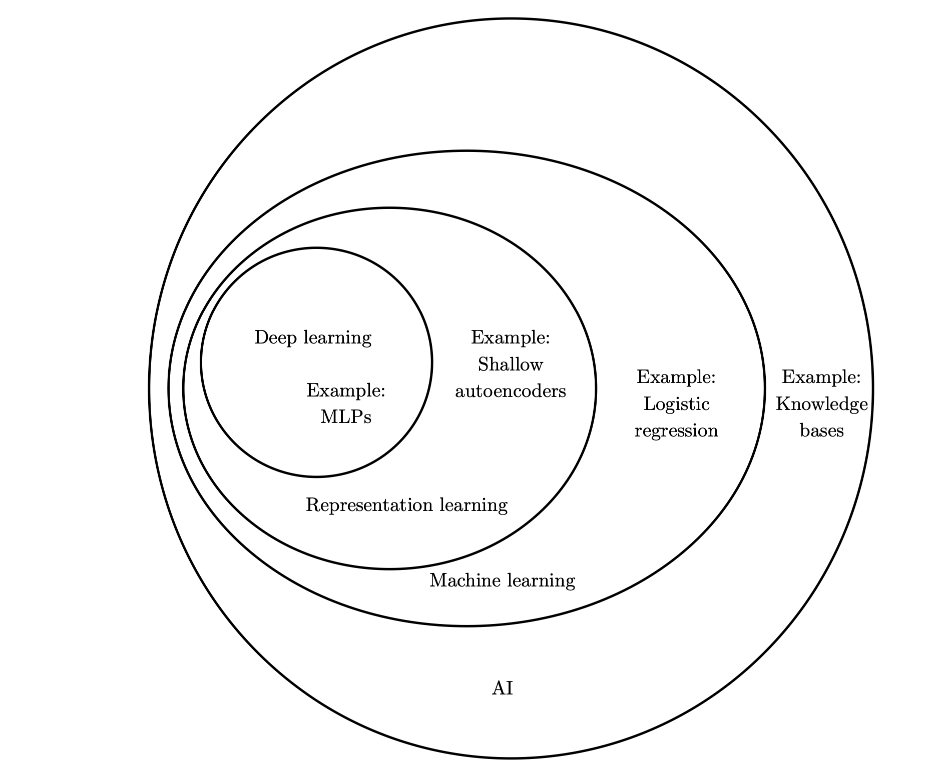

AI and machine learning
Source: Deep Learning, Ian Goodfellow et al, MIT press.

Slide 10
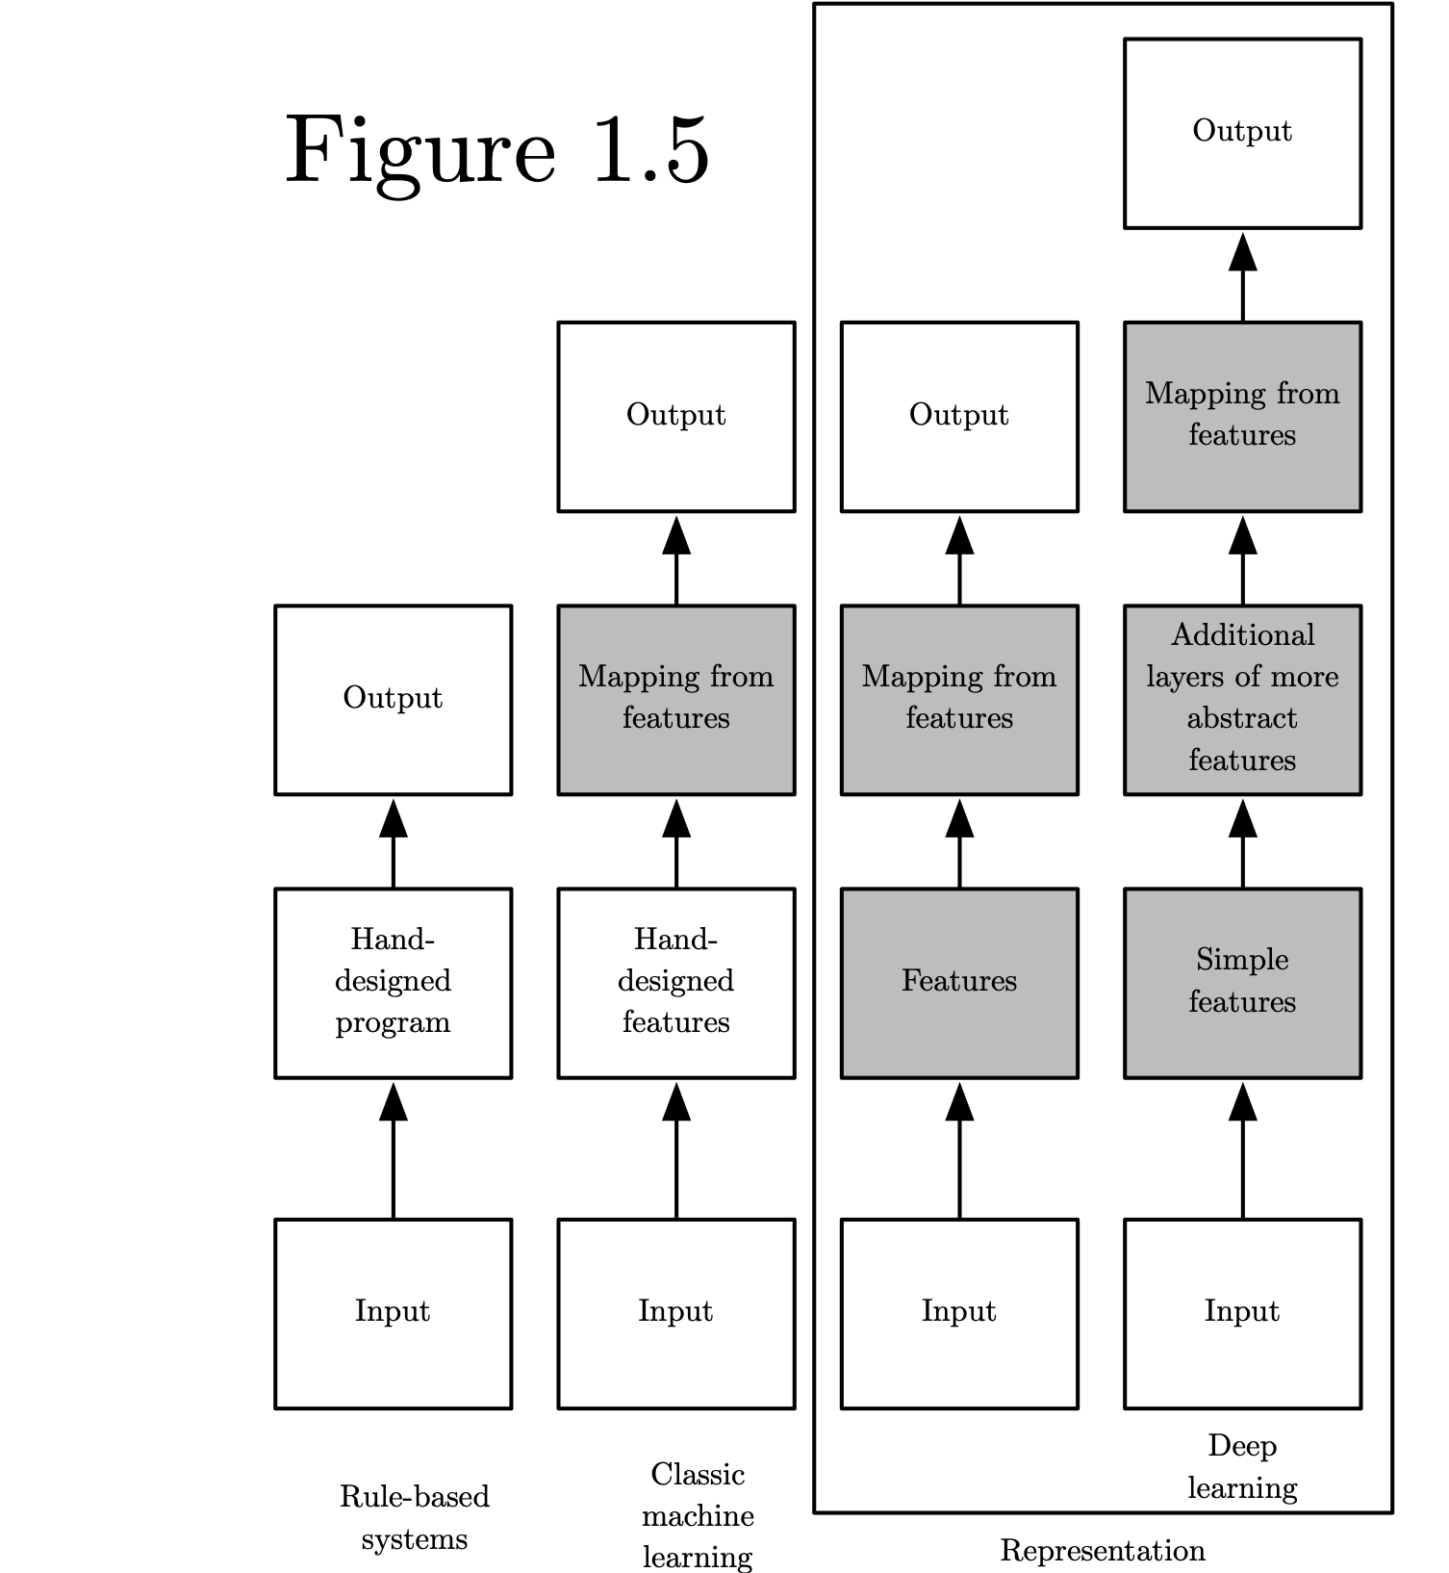
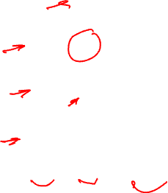
Categories of learning and intelligent systems
Source: Deep Learning, Ian Goodfellow et al, MIT press.

Slide 11
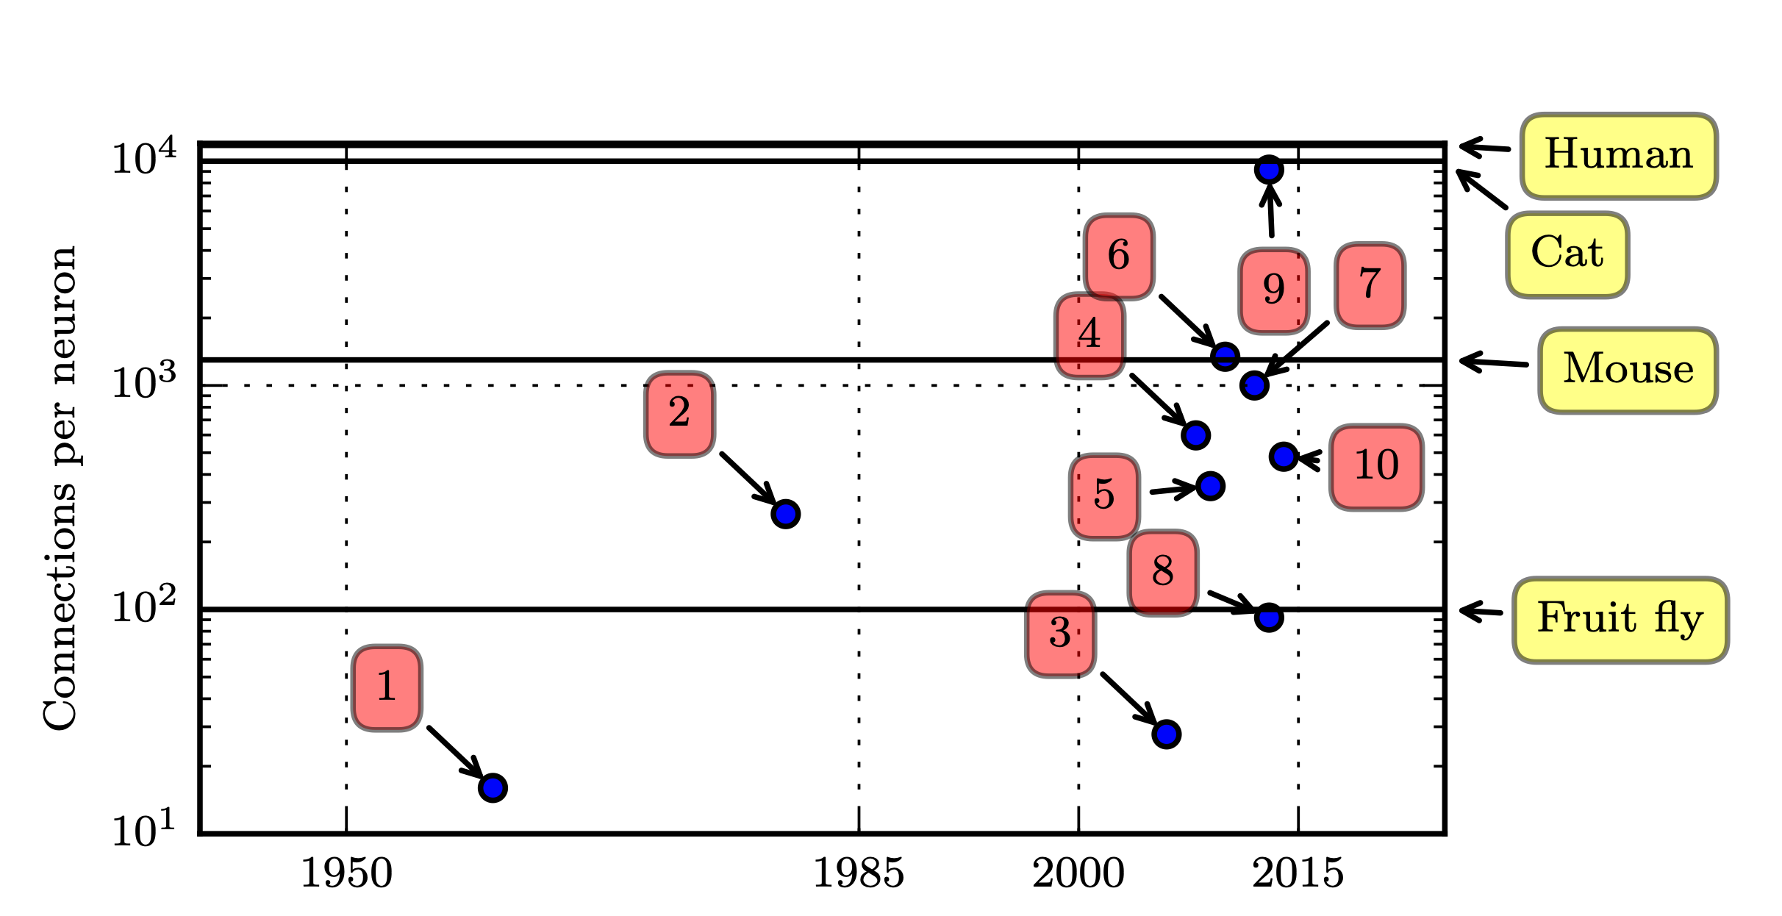
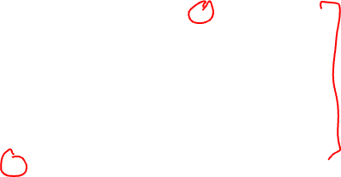
Connections per neuron
Adaptive linear element (Widrow and Hoff, 1960)
…
8. Multi-GPU convolutional network (Krizhevsky et al., 2012)
9. COTS HPC unsupervised convolutional network (Coates et al., 2013)
Source: Deep Learning, Ian Goodfellow et al, MIT press.

Slide 12
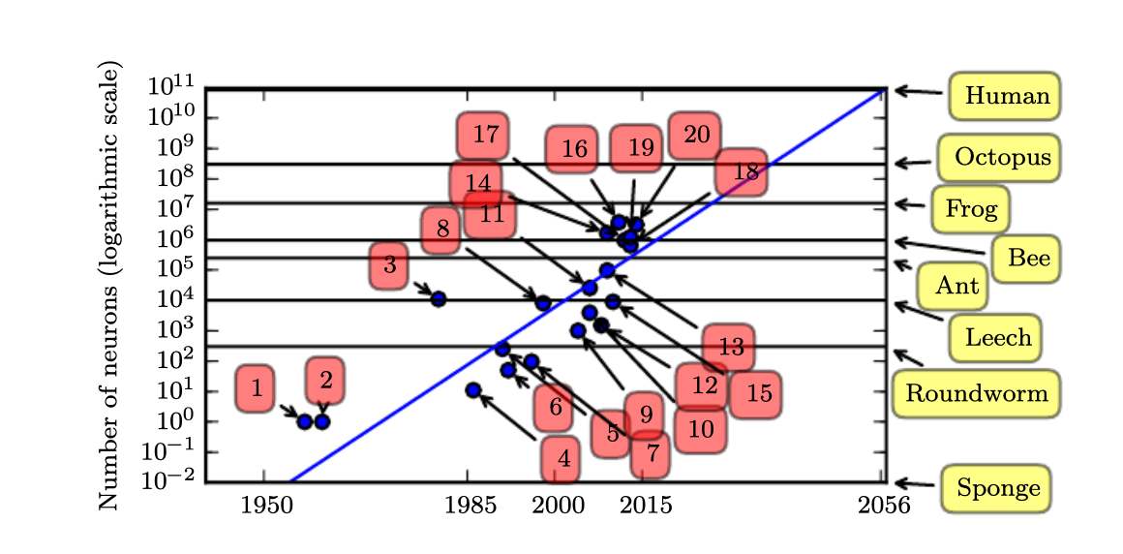
Number of neurons
17. Distributed autoencoder (Le et al., 2012)
18. Multi-GPU convolutional network (Krizhevsky et al., 2012)
19. COTS HPC unsupervised convolutional network (Coates et al., 2013)
20. GoogLeNet (Szegedy et al., 2014a)
Source: Deep Learning, Ian Goodfellow et al, MIT press.

Slide 13
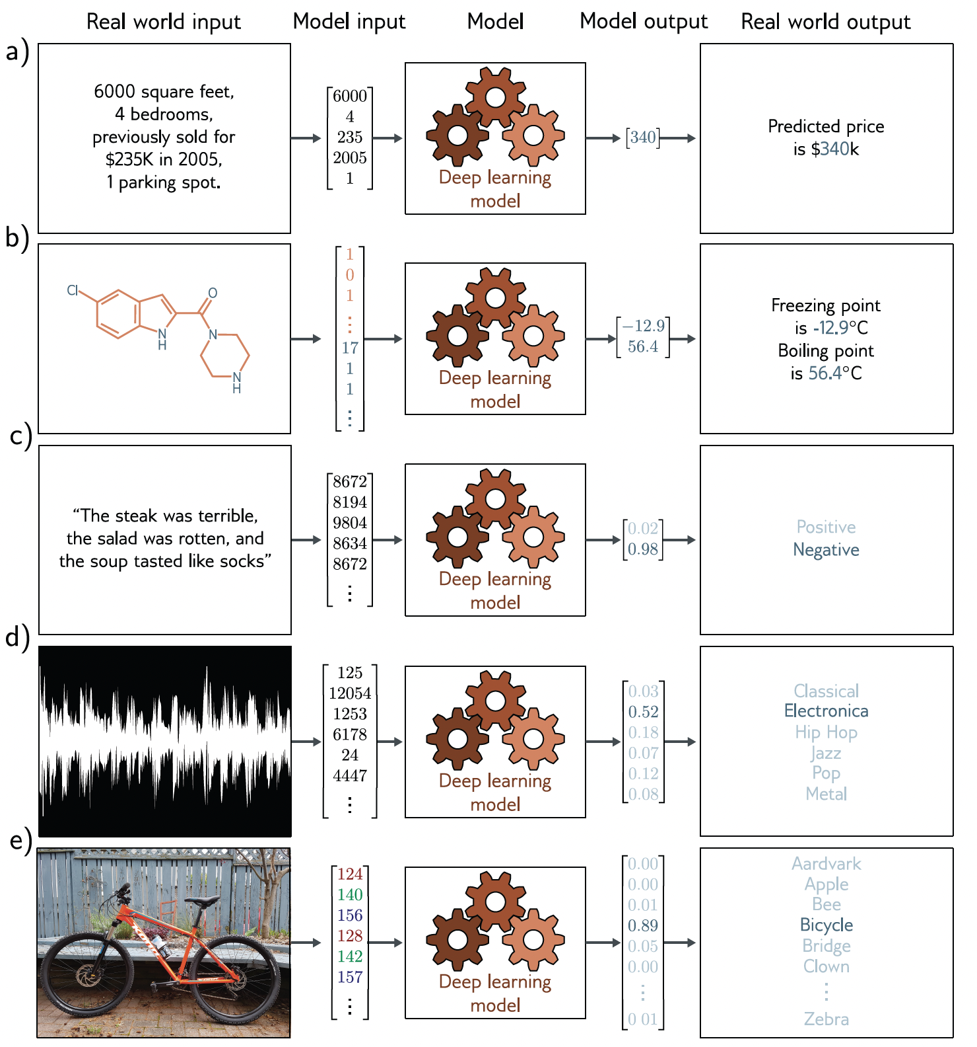
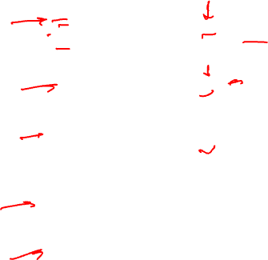
Machine learning models
Source: Understanding Deep Learning, Simon J.D. Prince, MIT Press.

Slide 14
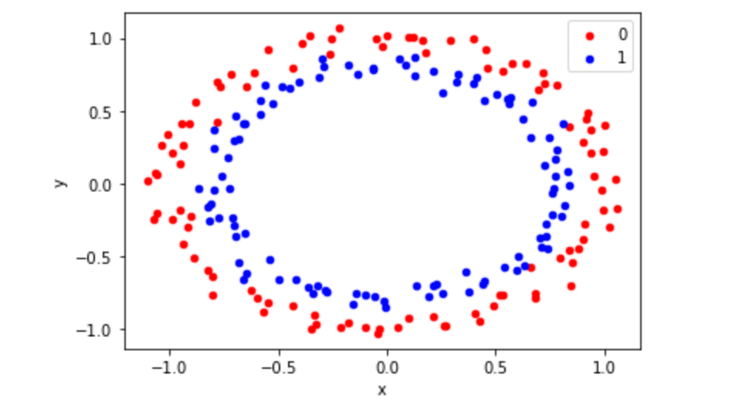
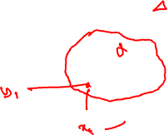
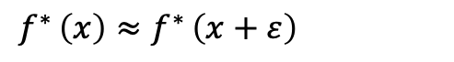

Machine learning
Most of machine learning methods designed as a learning process to learn a function f* for which:
- In other words, this means if we know the answer for a training sample x, then that answer is probably good in the neighborhood of x.
$f^{∗ }\left(x\right)≈$ $f^{∗ }\left(x+ε\right)$

Slide 15
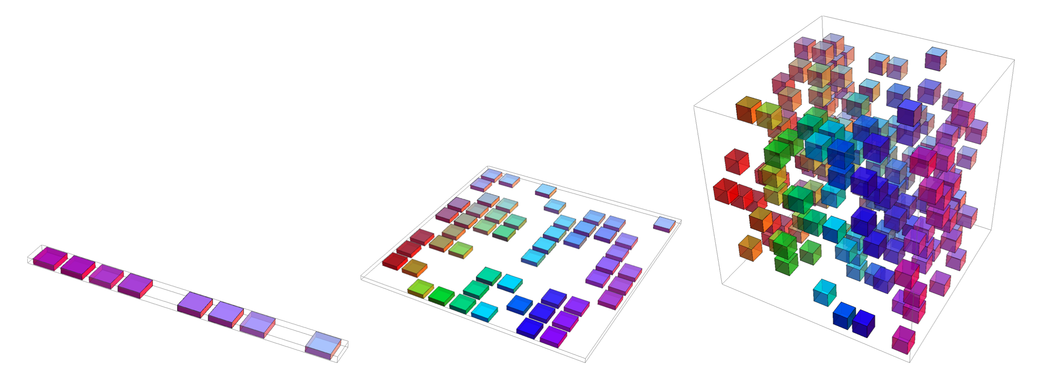
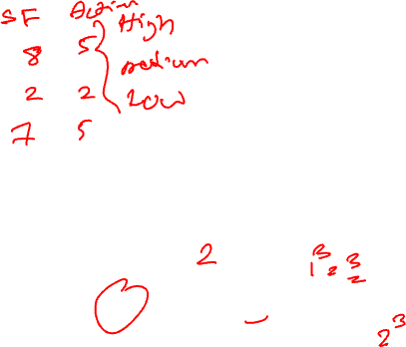
Curse of dimensionality
Overall, for d dimensions with v values we need O(v^{d}) regions and examples
Source: Deep Learning, Ian Goodfellow et al, MIT press.

Slide 16
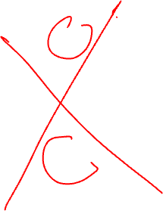
K-nearest neighborhood
Notes:
The geometric patterns uses veroni diagrams
The number of the contiguous regions cannot grow faster the number of training samples.

Slide 17
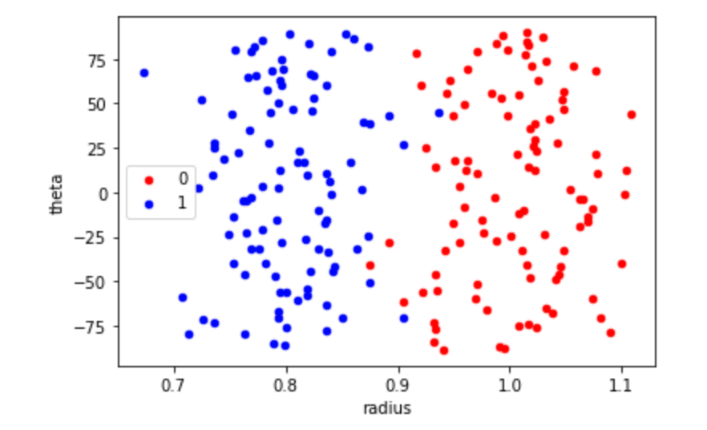
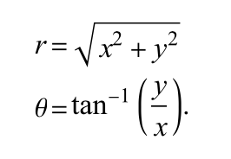
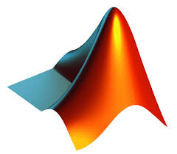

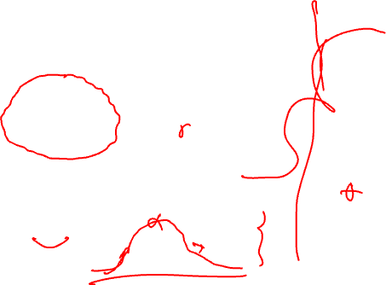
Data/sample representation
(x,y)
<Code>
https://github.com/PBarnaghi/Basic-ML-Code/

Slide 18
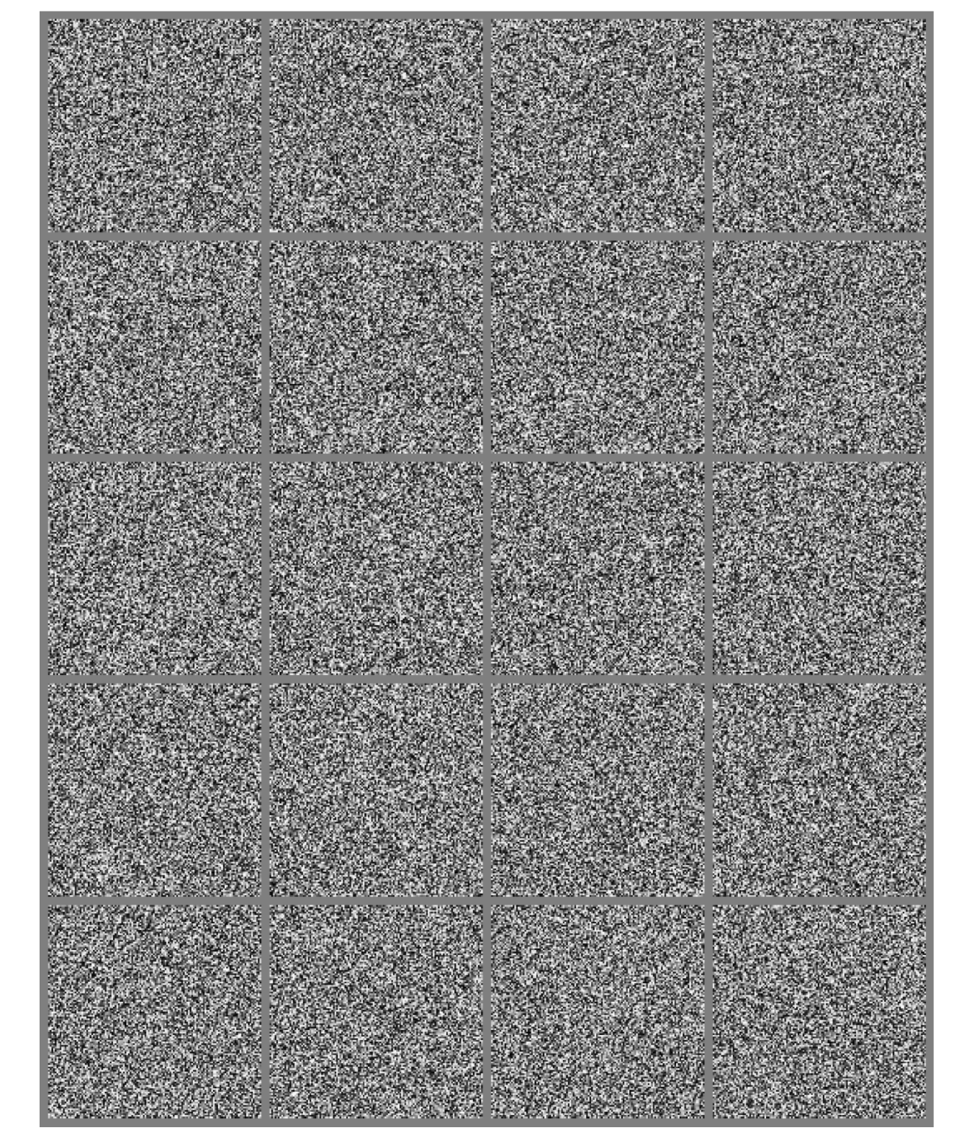
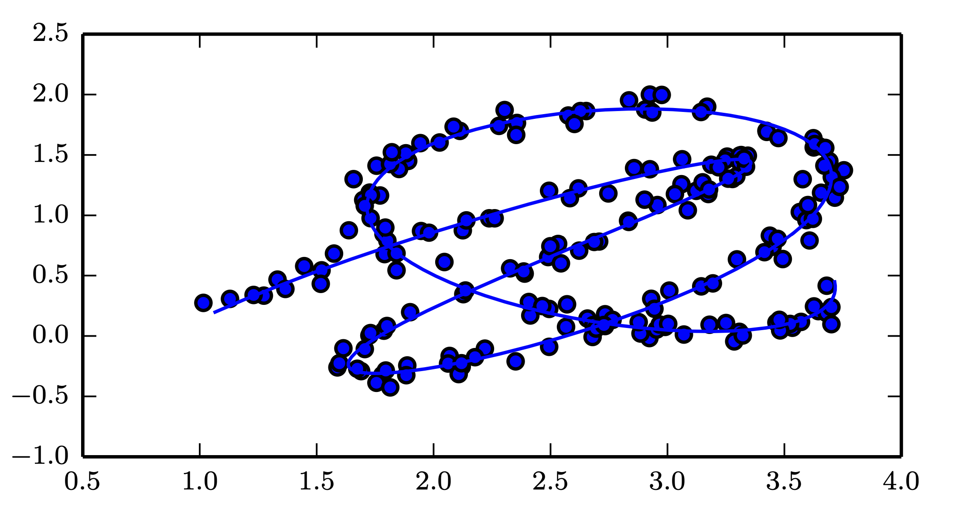

Manifold learning
Source: Deep Learning, Ian Goodfellow et al, MIT press.

Slide 19
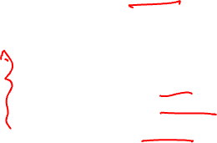
What you are going to learn in this module
Primary machine learning topics and concepts
Hands-on skills on how to:
Decide and choose suitable models
Design machine learning tasks/experiments
Choose and apply suitable metrics to evaluate the models
Identify and resolve common issues such overfitting/underfitting

Slide 20

By the end of this module
You should be able to:
Construct machine learning experiments
Create and run different probabilistic/statistical learning and deep learning models
Read and interpret existing work and assess their applicability/validity [to different use-cases]
Be familiar with common concepts such as training/test, cross-validation, performance evaluation metrics
Learn common issues and pitfalls in developing ML models
Obtain practical experience in developing ML models and running (simple) experiments.

Slide 21

Key topics covered
Introduction to machine learning
Regression models and linear prediction
Probability and information theory
Bayesian models and maximum likelihood estimation
Linear models, ensemble models and kernel functions
Artificial Neural Networks
Deep Neural Networks (DNN) and Deep Learning (DL)
Convolutional Neural Networks (CNNs)
Responsible machine learning and ethical considerations
Applications in neuroscience and neuroscience-inspired machine learning

Slide 22
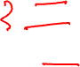
Module delivery
10 teaching sessions
Two primary tutorials and workshops (to provide background and primary programming and data handling/visualization skills)
2 hours lectures (Mon-Fri; 10-12:00) for two weeks in January 2024.
3 hours lab experiments (support by TAs)
1 final project (modeling and machine learning experiment on a small dataset)

Slide 23
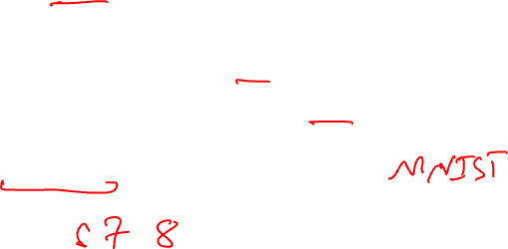
Datasets
Syntenic data and programmatical generated data to demonstrate the concepts
In home monitoring data in a dementia cohort study (movement, sleep, physiology and associated healthcare events) in the form of numerical time-series data. (Final Project)
Benchmark imaging data (non-medical) such as CIFAR-10
Publicly available clinical/experimental datasets
e.g. Physionet.org

Slide 24



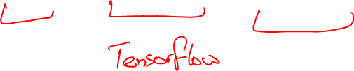
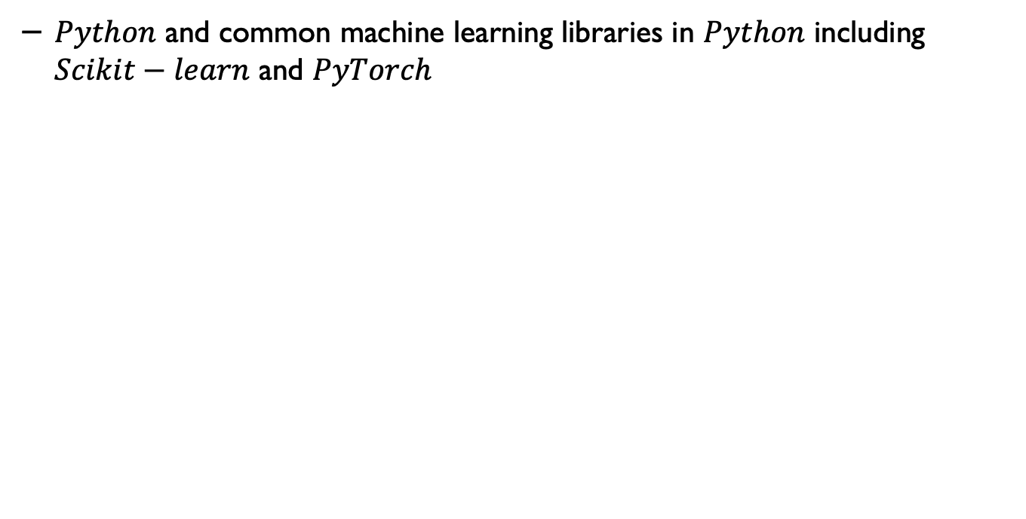
Tools and languages
$Python$ and common machine learning libraries in $Python$ including $Scikit−learn$ and $PyTorch$

Slide 25

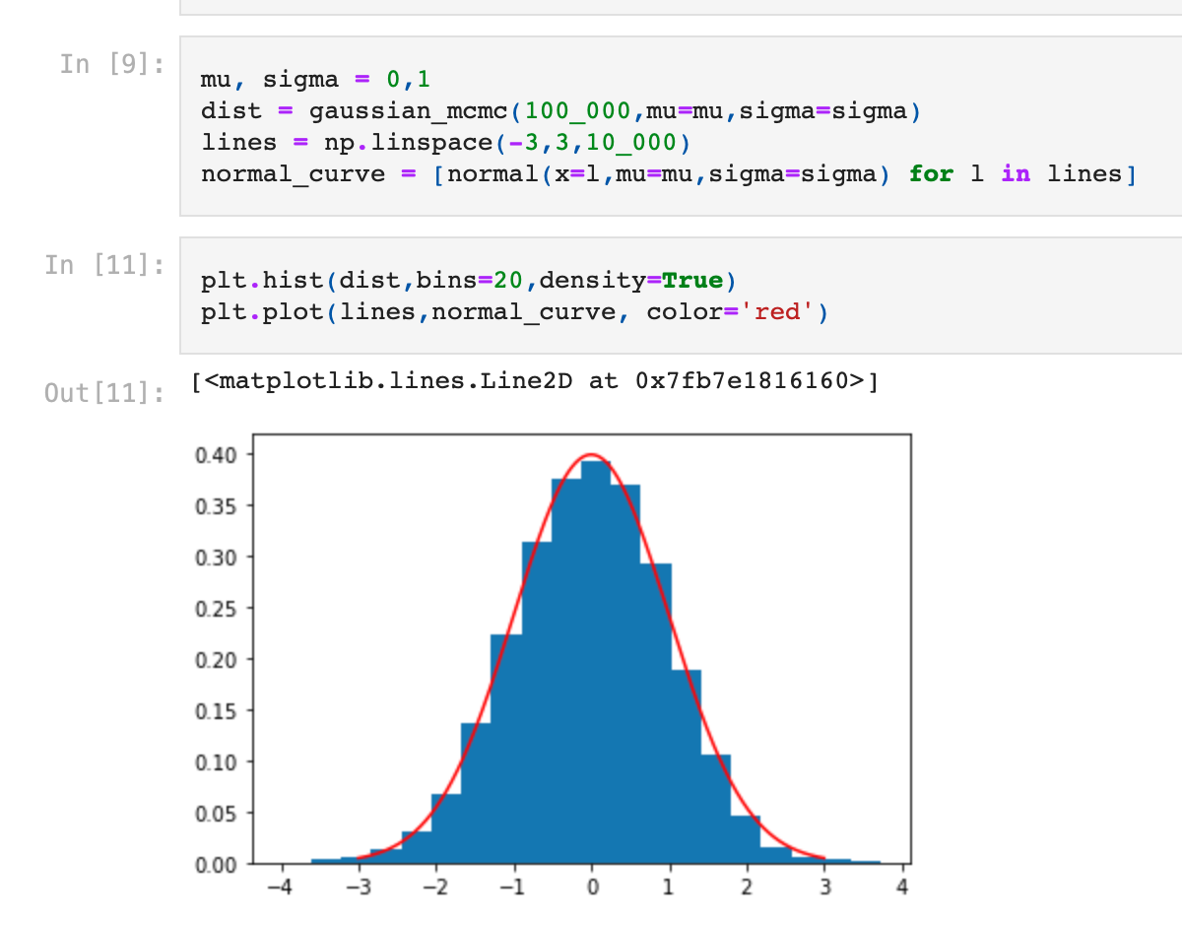
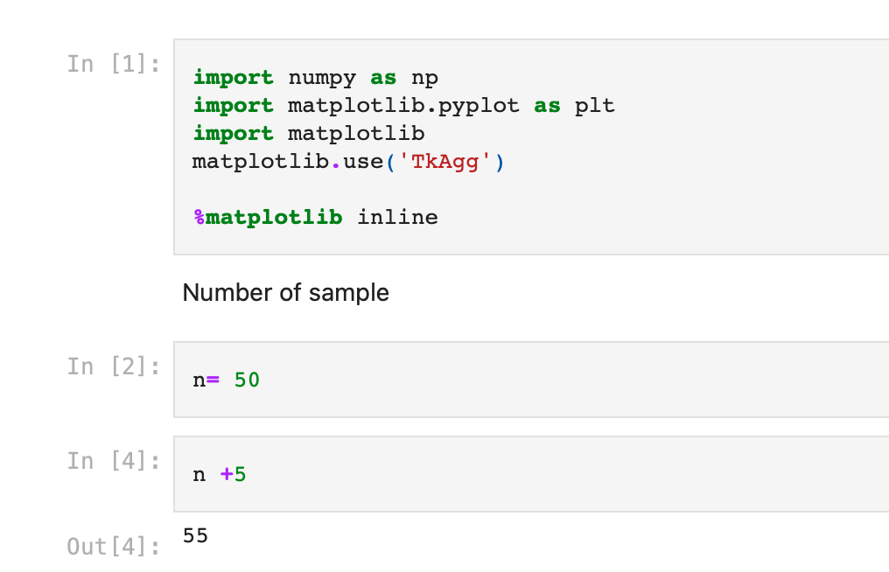
Development/learning framework

Slide 26
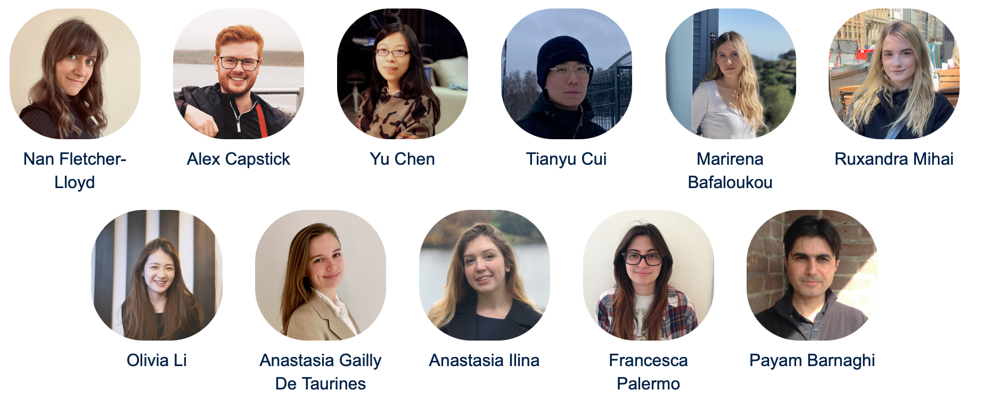
Teaching team

Slide 27
Frequently Asked Questions
I don’t know Python. Can I take this module?
Yes, we will provide an introductory lecture/workshop on Python (at the level that is required for this module).
I haven’t done any programming before. Can I still take this module?
Yes, but you should be prepared to learn scripting/programming and get familiar with the concepts quickly. We will provide examples/templates to follow and there are plenty of online material but there would be a steep learning curve.

Slide 28
Frequently Asked Questions
Machine learning seems to involve a lot of mathematics, especially statistics and probability. Do I need to know all these before taking this module?
You need to be familiar with the basic concepts of statistics and probability- but we have provided a brief refresher online tutorial. The lecture content/concepts will not be mathematically focused but when needed the underlying mathematical concepts will be described/shown to elaborate the concepts.
Learning mathematical concepts in a group is often easier.
We will focus on concepts and skills that won’t be easy to find/learn by watching a series of online videos.

Slide 29
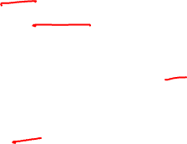
Concepts that will not be covered in this module
Image processing and machine learning for medical imaging
Natural language processing and text analysis
Advanced machine learning and deep learning concepts such as transfer learning, generative models (some of these will be covered in an optional series after the module)
Signal processing and feature engineering for specific modalities/data such as EEG, ECG, Brain imaging

Slide 30

What will I learn in this module?
Primary concepts and foundations of machine learning (statistical/probabilistic learning and deep learning models).
Some of basic/key models to design and develop supervised and unsupervised machine learning.
Cross-validation, hyperparameter optimisation, evaluation metrics
Hands-on skills and working with real-world data and designing/evaluating models with different real-world datasets.
Ultimately this module (hopefully) will help you learn fundamental concepts on how ML models are constructed and applied to real-world problems.

Slide 31

Module assessment
3 Marked Lab assignments (40%)
Lab 5 (Friday)
Lab 6 (Monday)
Lab 8 (Wednesday) – this will be a 1-page report on a use-case that will be given to review/evaluate.
Final project (60%)
On the 2nd week, we will give you a dataset and ask you to:
Conduct a set of exploratory data analysis
Develop a simple ML model and evaluated it
Submissions on 31st of January 2024 (5:00pm)
Code with mark down in Jupyter notebook will be sufficient.

Slide 32
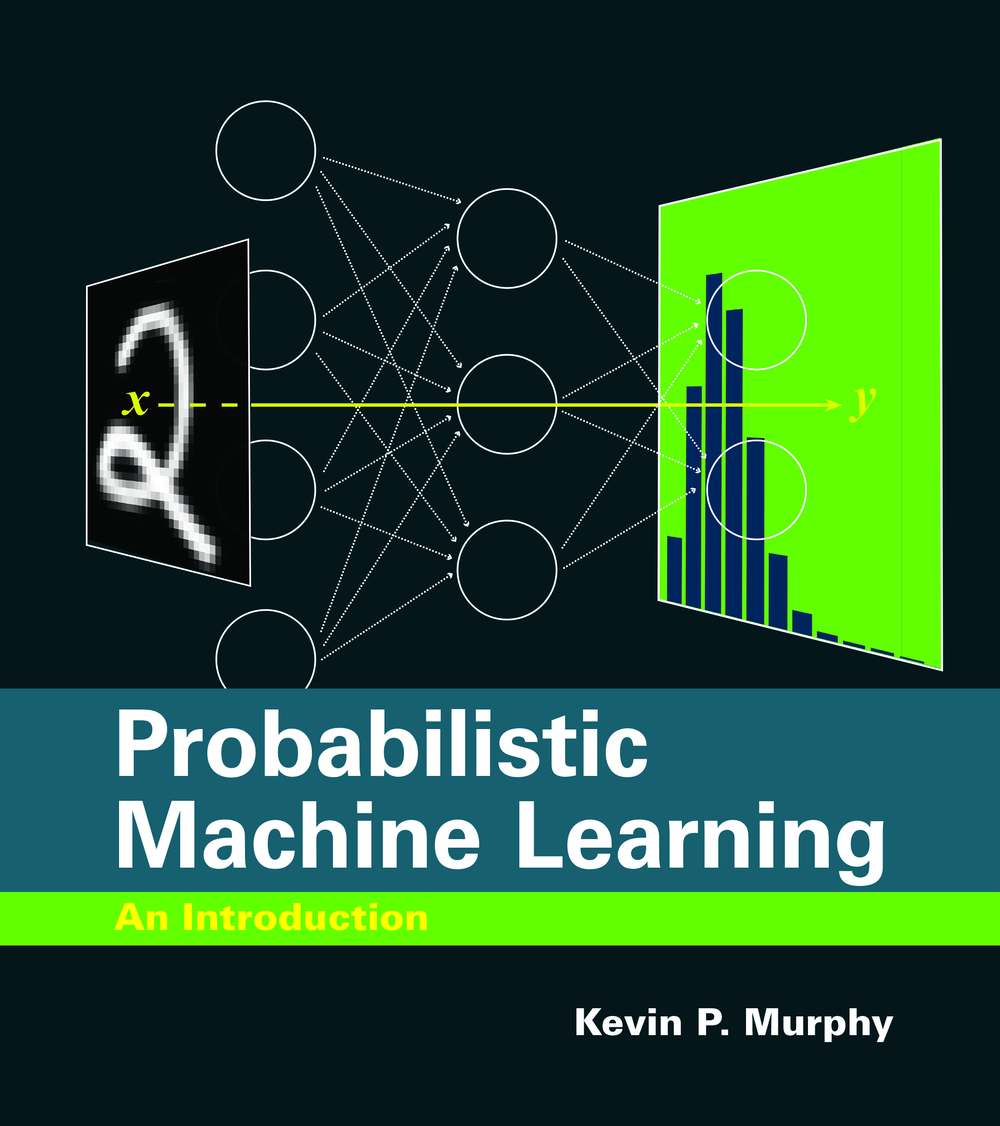
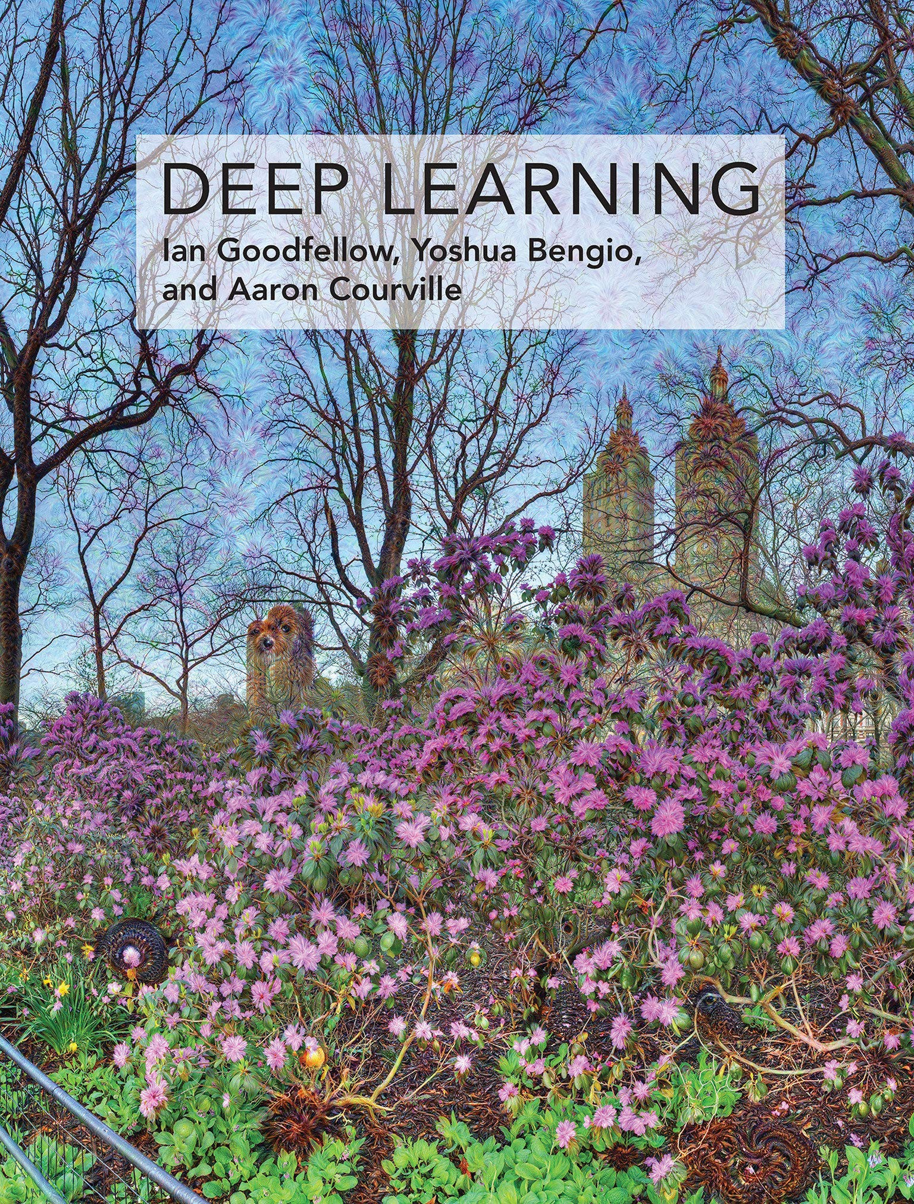
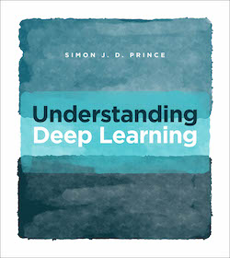
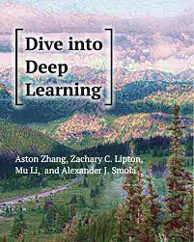
Reference and sources
Probabilistic Machine Learning Kevin P. Murphy, MIT Press
Deep Learning
Goodfellow et al., MIT Press
Understanding Deep Learning, Simon J.D. Prince, MIT Press
Dive into Deep Learning
Aston Zhang et al.
Preprints:
Probabilistic Machine Learning: An Introduction, https://probml.github.io/pml-book/book1.html
Deep learning: https://www.deeplearningbook.org
Understanding Deep Learning, https://udlbook.github.io/udlbook/
Dive into deep learning, https://d2l.ai/index.html

Slide 33

Some other online sources
Andrew Ng lecture notes: https://cs229.stanford.edu/lectures-spring2022/main_notes.pdf
https://towardsdatascience.com/machine-learning/
Good online sources for questions/troubleshooting
https://stackoverflow.com
https://stackexchange.com

Slide 34
Typical machine learning approaches
Supervised learning
Unsupervised learning
Reinforcement learning

Slide 35
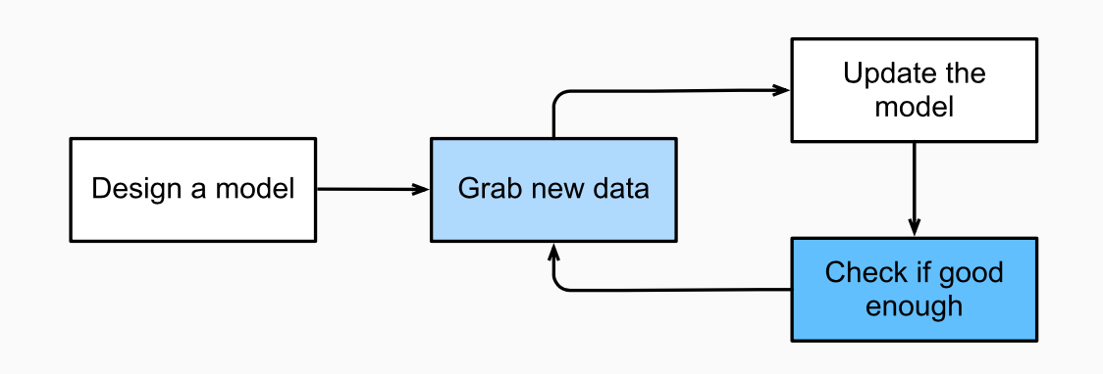
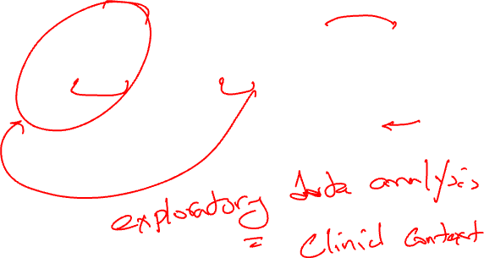
Machine learning development
Is this the right approach?
Source: Dive into Deep Learning, Aston Zhang et al.

Slide 36

Key components of ML development
The data that we can learn from.
A model of how to transform the data.
An objective function that quantifies how well (or badly) the model is doing.
An algorithm to adjust the model’s parameters to optimise the objective function.
Source: Dive into Deep Learning, Aston Zhang et al.

Slide 37
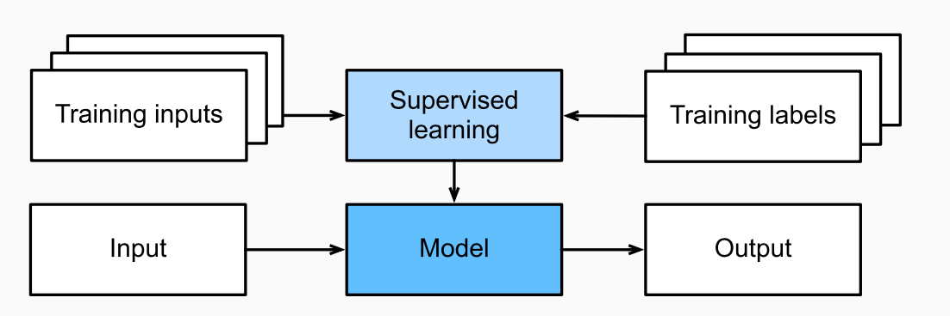
Supervised learning
In supervised learning the data comes with additional attributes (i.e. labels) that we want to predict.
Source: Dive into Deep Learning, Aston Zhang et al.

Slide 38
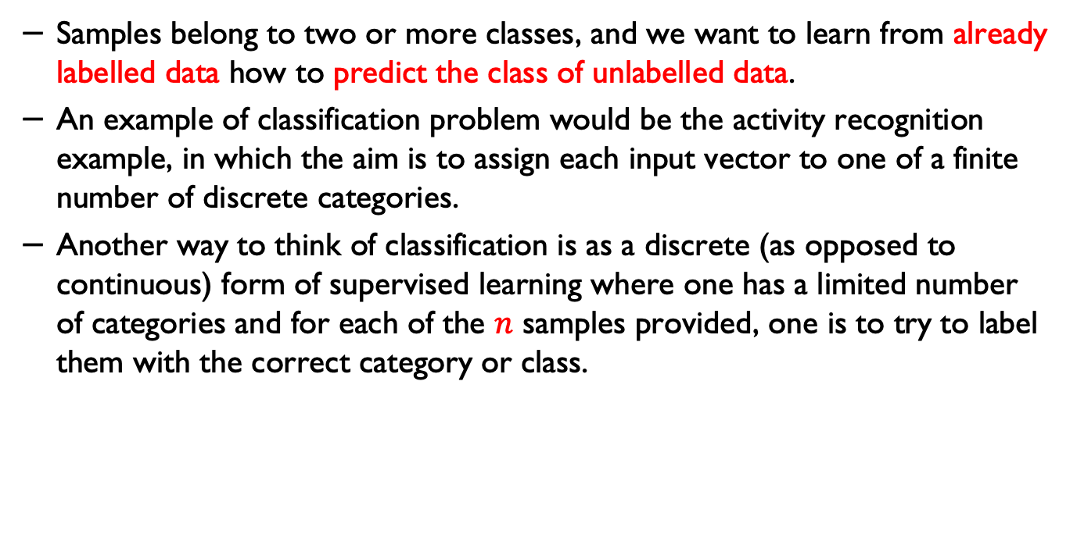

Classification
Samples belong to two or more classes, and we want to learn from already labelled data how to predict the class of unlabelled data.
An example of classification problem would be the activity recognition example, in which the aim is to assign each input vector to one of a finite number of discrete categories.
Another way to think of classification is as a discrete (as opposed to continuous) form of supervised learning where one has a limited number of categories and for each of the $n$ samples provided, one is to try to label them with the correct category or class.
Source: Scikit learn documentation

Slide 39
Regression
If the desired output consists of one or more continuous variables, then the task is called regression.
An example of regression problems:
How long will it take for an AD patient to decline and have severe functional and cognitive impairment? (judging by previously seen data)
How long will take for a patient to decline from one stage to another stage (in a neurodegenerative condition)?
Predicting length of hospital stay for a patient

Slide 40
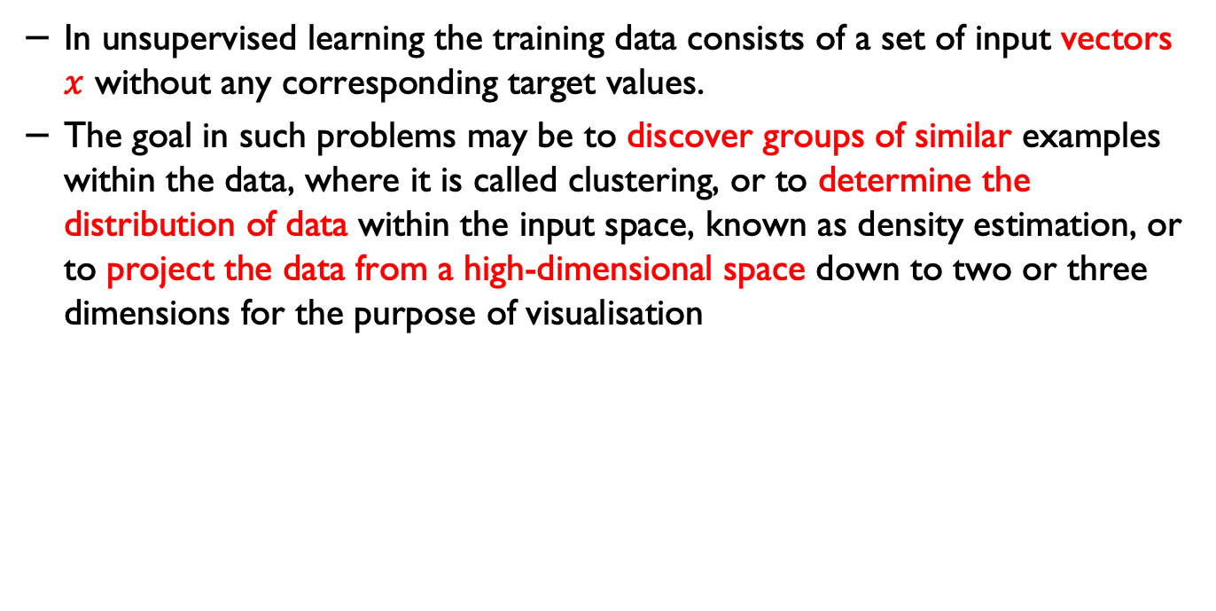
Unsupervised learning
In unsupervised learning the training data consists of a set of input vectors $x$ without any corresponding target values.
The goal in such problems may be to discover groups of similar examples within the data, where it is called clustering, or to determine the distribution of data within the input space, known as density estimation, or to project the data from a high-dimensional space down to two or three dimensions for the purpose of visualisation
Source: Scikit learn documentation

Slide 41
Training set and testing set
Machine learning is about learning some properties of a data set and applying them to new data.
This is why a common practice in machine learning to evaluate an algorithm is to split the data at hand into two sets, one that we call the training set on which we learn data properties and one that we call the testing set on which we test these properties.
Source: Scikit learn documentation

Slide 42
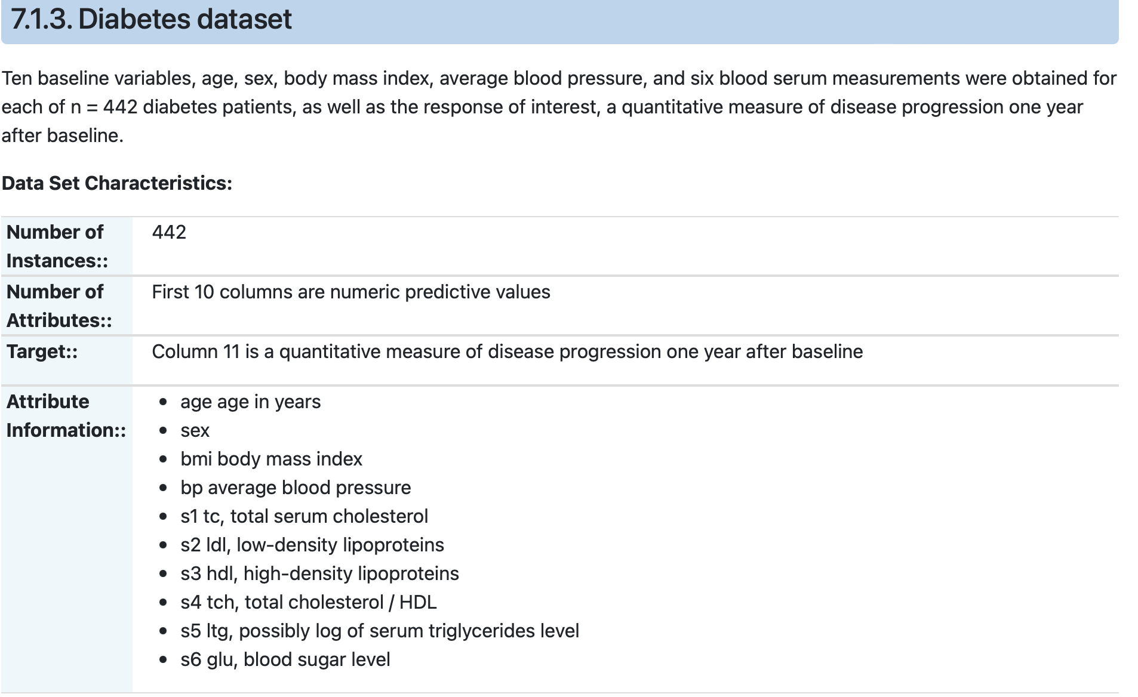
Dataset
https://www4.stat.ncsu.edu/~boos/var.select/diabetes.html

Slide 43
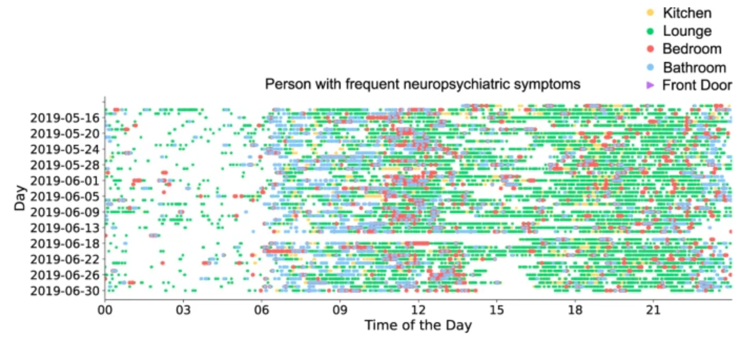
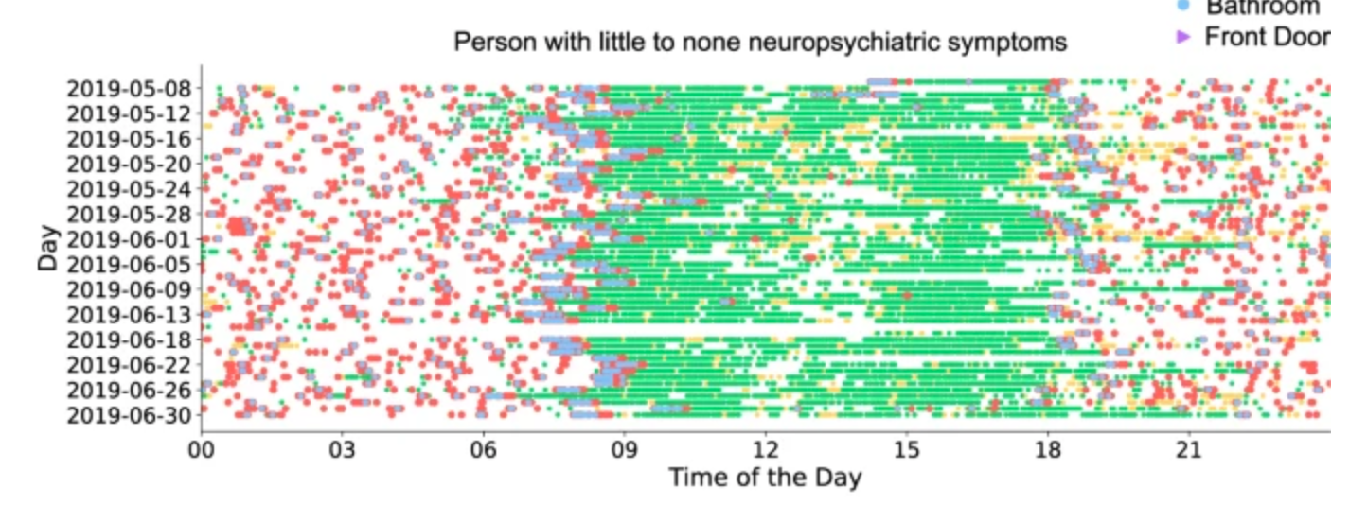
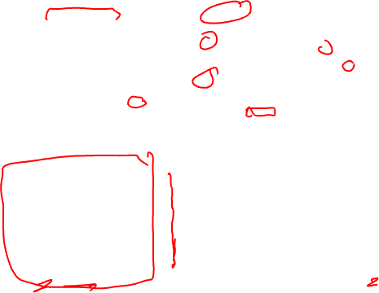
Datasets
Palermo, F., Chen, Y., Capstick, A. et al. TIHM: An open dataset for remote healthcare monitoring in dementia. Sci Data 10, 606 (2023).

Slide 44
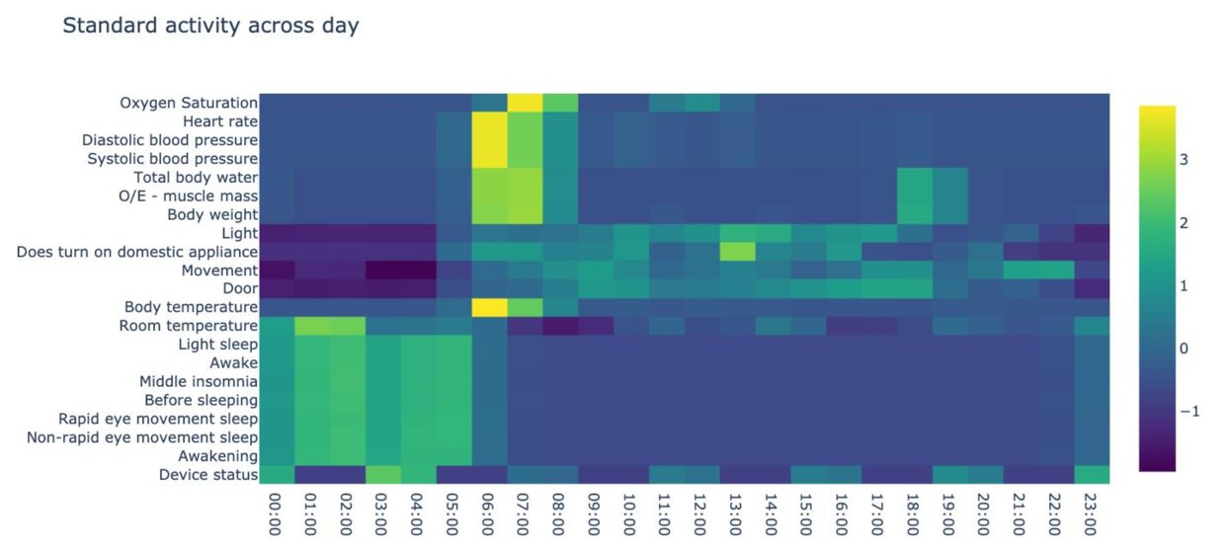

A sample data for in-home activity

Slide 45
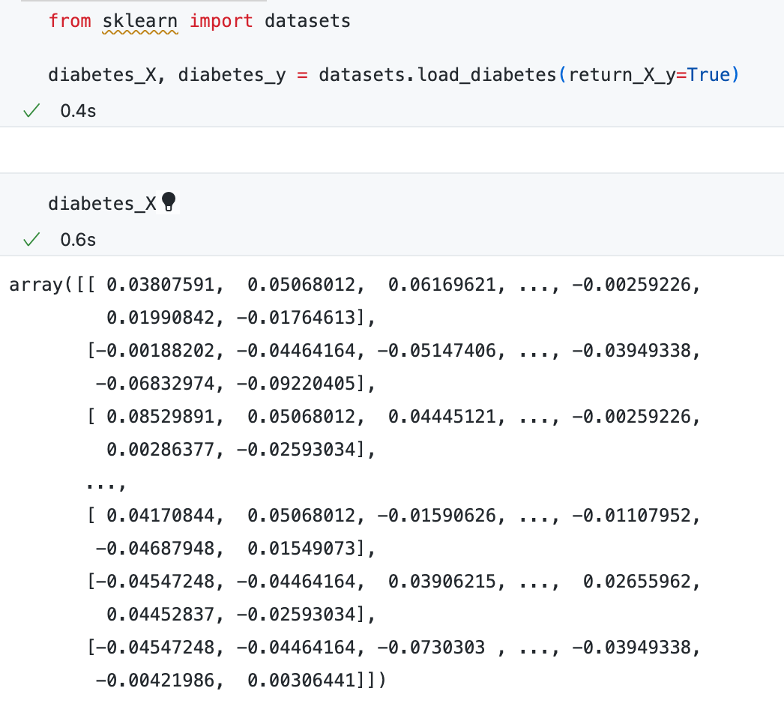
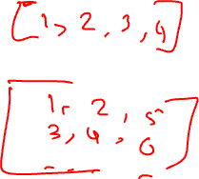
Dataset in the code/programming environment

Slide 46
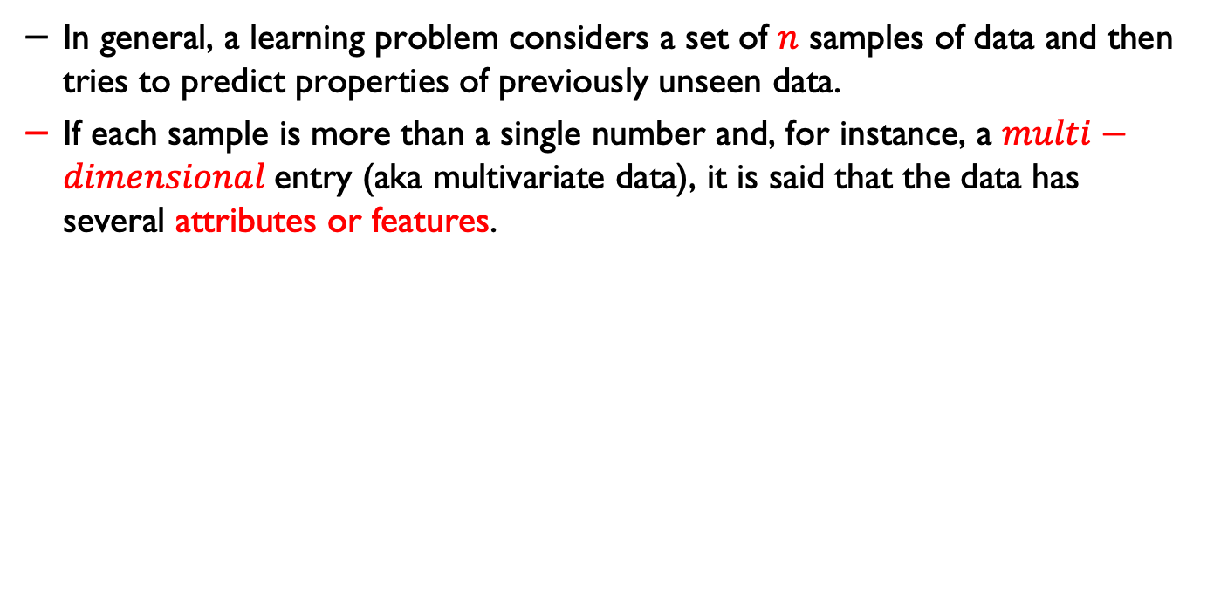
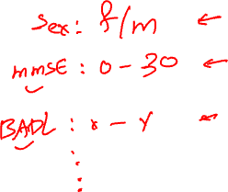
Multivariate data
In general, a learning problem considers a set of $n$ samples of data and then tries to predict properties of previously unseen data.
If each sample is more than a single number and, for instance, a $multi−dimensional$entry (aka multivariate data), it is said that the data has several attributes or features.

Slide 47
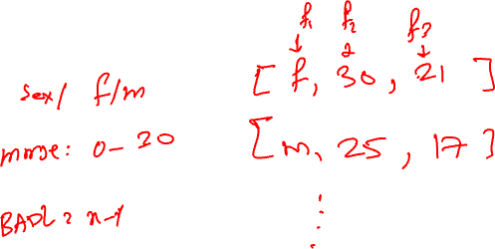
Feature vector

Slide 48

Training, Test and Validation
Training: is used to training the algorithms and determine their parameters (e.g. weights in a neural network).
Validating: Once you have a collection of algorithms, you need to pick one algorithm. Sometimes the algorithm that performs best on the validation set is picked up.
Testing: Once a an algorithm is chosen but we don't know yet how it’s performance on real-world data. We can apply the chosen algorithm to a test set in order to see its performance on unseen data.
How to divide the data? e.g. 60%, 20%, 20%
Source: Scikit learn documentation

Slide 49


Unsupervised learning
J. Li et al., under review, 2023.
Length of stay (log scale)
Rate of emergency surgeries
Image source: J. Li et al., under review, 2023.

Slide 50
Clustering
The problem that needs to be solved in clustering:
For example, given a dataset, if we knew that there were 3 types of data, but did not have access to a taxonomist (i.e. labels) to directly identify them: we could try a clustering task.
This means splitting the data into well-separated group called clusters.

Slide 51

K-means clustering
The $KMeans$ algorithm clusters data by trying to separate samples in $n$ groups of equal variance, minimising a criterion known as the inertia or within-cluster sum-of-squares.
This algorithm requires the number of clusters to be specified. It scales well to large number of samples and has been used across a large range of application areas in many different fields.
The k-means algorithm divides a set of $N$ samples $X$ into $K$ disjoint clusters $C$, each described by the mean $μj$ of the samples in the cluster.
Source: Scikit learn documentation

Slide 52



K-means

Slide 53




K-Means
The means are commonly called the cluster “centroids”; note that they are not, in general, points from $X$, although they live in the same space.
The K-means algorithm aims to choose centroids that minimise the inertia, or within-cluster sum of squared criterion:
$$\sum_{i=0}^{n}{\min{({\left\|μ_{j} −μ_{i}\right\|}^{2})}}$$
$μ_{j}∈C$

Slide 54

How K-means works
K-means has three steps.
The first step chooses the initial centroids, with the most basic method being to choose k samples from the dataset $X$.
After $initialisation$, K-means consists of looping between the two other steps.
The first step assigns each sample to its nearest centroid. The second step creates new centroids by taking the mean value of all of the samples assigned to each previous centroid.
The difference between the old and the new centroids are computed and the algorithm repeats these last two steps until this value is less than a threshold. In other words, it repeats until the centroids do not move significantly.

Slide 55

K-Means Algorithm
First the initial cluster for each of the points is calculated using the current centroids.
Secondly, the centroids are updated to the mean of each segment.
The algorithm then repeats this until a stopping criterion is fulfilled (e.g. error rate below a certain threshold).
Or for example iteration stops when centroids move less than a threshold.

Slide 56
Convergence in K-means
Given enough time, K-means will always converge, however this may be to a local minimum. This is highly dependent on the initialisation of the centroids.
As a result, the computation is often done several times, with different initialisations of the centroids.
Generally, repats are very important in developing robust machine learning models (more on this in the coming days).

Slide 57
Convergence in K-means
One method to help address this issue is the “k-means++” initialisation scheme, which has been implemented in scikit-learn (use the init='kmeans++' parameter).
This initializes the centroids to be (generally) distant from each other, leading to provably better results than random initialisation, as shown in the reference.
Source: Scikit learn documentation

Slide 58

K-means Example
Before you need to install sci-kit learn
In Mac OS
$sudo easy_install pip$
$pip install −U numpy scipy scikit−learn$
In Linux
$sudo apt−get install build−essential python−dev python−setuptools \backslash python−numpy python−scipy \backslash libatlas−dev libatlas3gf−base$

Slide 59
Practice questions

Slide 60
Practice questions
In a machine learning experiment, we have 1000 samples. We divide the data into training, validation and test sets as below:
Training samples: 300
Validation samples: 200
Test samples: 500
Is this a good split?
Please go to menti.com and add your response (code will be given)

Slide 61
Hospital stay
In a machine learning experiment, you have been asked to design a model that can predict hospital stays for people who are admitted to a neurology ward.
What type of model will you use to design your model?

Slide 62
If you have any questions
Please feel free to arrange a meeting or email (p.barnaghi@imperial.ac.uk).
My office: 928, Sir Michael Uren Research Hub, White City Campus.

